Slide 1
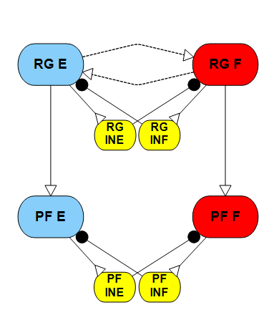





Goal:
Investigate how neural parameters and external inputs impact the performance of the two-layer CPG, establishing a design process and tools for future locomotion studies and robot controllers.
Step 1
RG frequency control
Determine how Gw and drives/feedback influence the rhythm generation of the RG component.
Step 2
RG phase response curve
Investigate the influence of the Gw on the phase response to perturbations.
Step 3
Phase shift between the two layers of CPG
Quantify the phase shifts between the two layers of CPG caused by different stimulus/feedback.
$$D_{1}$$
$$G_{w}$$
$$G_{c}$$
$$G_{c}$$
$$D_{2}$$

Slide 2
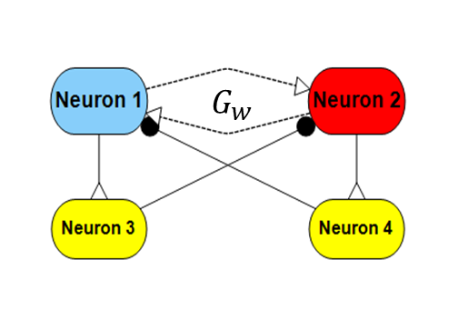

RG frequency control
$$D_{1}$$
2.09
4.372
6.0152
If we want a desired frequency of 1.1136 Hz, there are infinite solutions found by varying Gw and D1 Stimulus. For example, possible solutions are [Gw D1] = [0 6.0152]; [0.1 4.372]; [0.3 2.09]; [0.59 0].

Slide 3
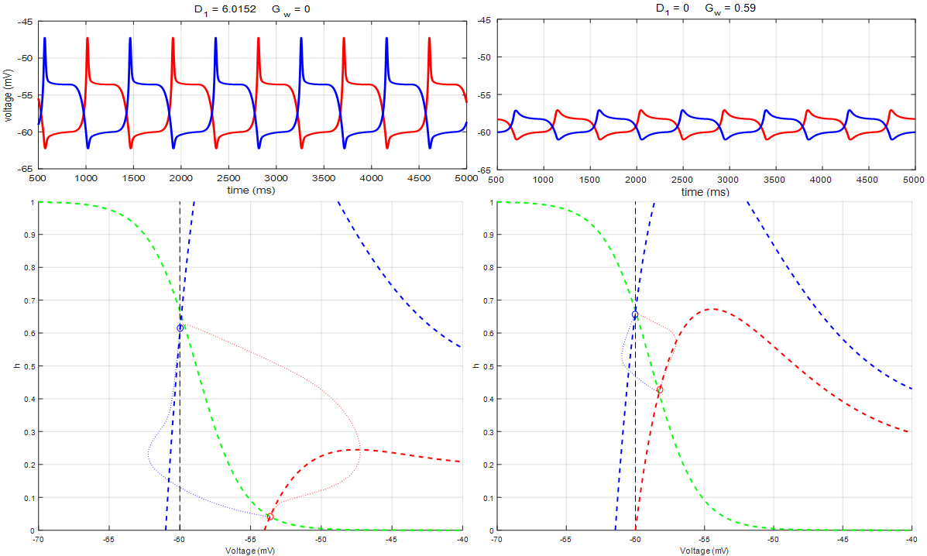
However, the performance for different conductances is not the same. Larger Gw value resulting smaller phase orbit at the same frequency.

Slide 4
RG phase response curve
The perturbation response when an excitation stimulus of 5 nA injected into the extensor neuron during 0.3-0.5 of the normalized phase duration.
Top column:
Extensor neuron activities for unperturbed situation
Flexor neuron activities for unperturbed situation
Extensor neuron activities for perturbed situation
Flexor neuron activities for perturbed situation
Bottom column:
Neuron actives for the extensor neurons in the phase plane.
D = 6.0152; Gw= 0
D=0; Gw=0.59
As the phase orbit size is shrink by the Gw, when encountering same level of perturbation, the phase response is different.

Slide 5
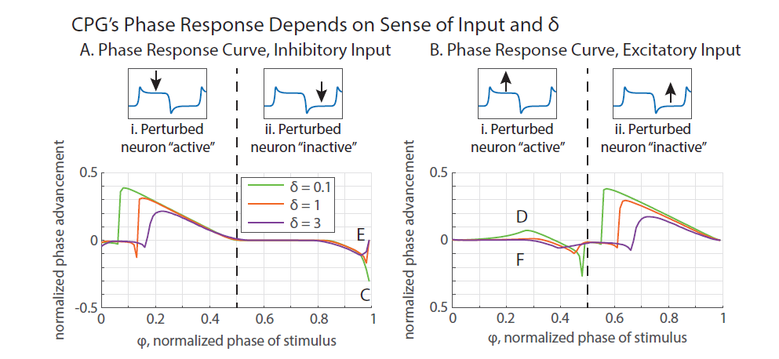

RG phase response curve
Previous work by NS determined the PRC of insect model while varying G
$$D_{1}$$
G
I set Gw as zero and reproduced the results as shown in the figures using parameter values in reference.
Then I produced the phase response curve using rat’s neural parameters.
Then I investigated how Gw affects the phase response curve.

Slide 6
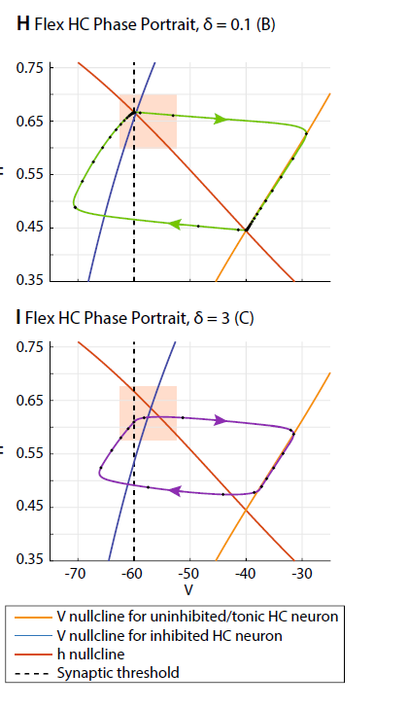
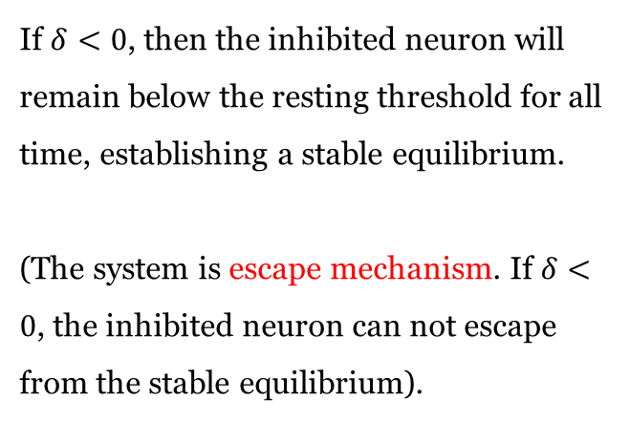

What is $δ$?
The strength of the synaptic inhibition establishes the difference between the inhibited neuron’s resting potential $V_{∞,inh}$, and the synaptic threshold $E_{lo}$, which we define as $δ$:
$$δ=V_{∞,inh}−E_{lo}$$
If $δ<0$, then the inhibited neuron will remain below the resting threshold for all time, establishing a stable equilibrium.
(The system is escape mechanism. If $δ<0$, the inhibited neuron can not escape from the stable equilibrium).
Gw = 0; increasing the drive
h - nullcline
Threshold
D = 0
D = 2
D = 4
D = 6

Slide 7
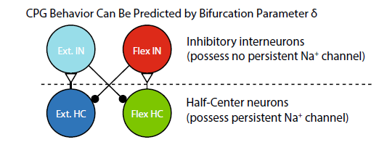
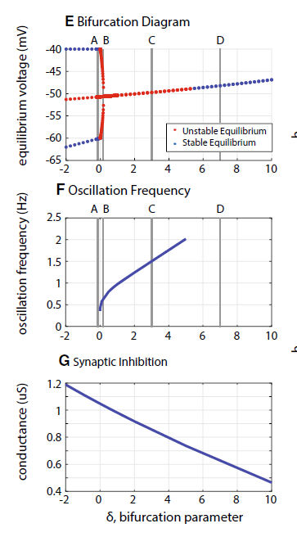
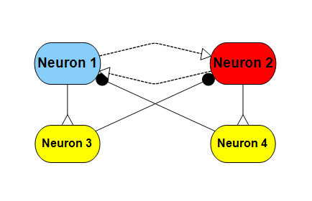


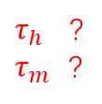
I reproduced the result from NS’s work.
Interneurons: C_{m} = 5 nF, G_{m} = 1 uS, G_{Na} = 0 uS ,E_{r} = -60 mV.
HC Neurons: C_{m} = 5 nF, G_{m} = 1 uS, G_{Na} = 1 uS, E_{Na} = 50 mV,
A_{h} = 0.5, S_{h} = -0.046, E_{h} = -60 mV,
A_{m} = 1, S_{m} = 0.046, E_{m} = - 40 mV.
$τ_{h}$ ?
$τ_{m}$ ?
HC→IN: g_{Syn} = 0.118 uS, E_{s} = 300 mV.
E_{lo} = -60 mV, E_{hi} = - 20 mV.
IN→HC: g_{Syn} = 1.041 uS, E_{s} = -100 mV.
E_{lo} = -60 mV, E_{hi} = - 20 mV.
$τ_{h}$ = 500 ms
$τ_{m}$= 2 ms
$$G_{w}$$

Slide 8
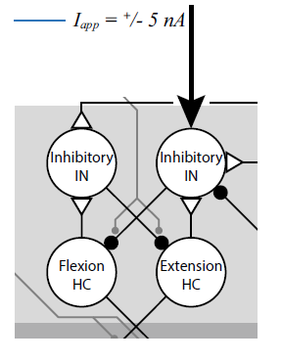
I reproduced the result from NS’s work.

Slide 9

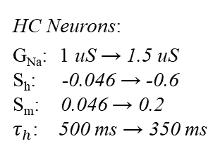


Rat’s parameter CPG is more sensitive to external inputs.
HC Neurons:
G_{Na}: 1 uS → 1.5 uS
S_{h}: -0.046 → -0.6
S_{m}: 0.046 → 0.2
$τ_{h}$: 500 ms → 350 ms
Synapse:
E_{hi}: -20 mV → -40 mV
NS:
$$±5 nA$$
R
When comparing rat’s PRC with insect’s PRC from NS’s work. The rat’s model has a sharper PRC when the same level of external stimulus involved.
When the external current in rat model reduced to 0.5 nA (10 % of insect’s current), the PRC is then similar to NS’s work.
Rat:
$$±5 nA$$
$$±0.5 nA$$
Notes:
HC determine the voltage range.

Slide 10
Changing the parameters results a smaller phase orbit (~10%) which is the reason why the system is more sensitive to the same current stimulus.
NS:
Rat:

Slide 11
Same frequency, external drive make the PRC less sensitive to stimulus.
When we investigating the phase response curve for the RG at the same frequency. The figure shows external drive make the RG less sensitive to stimulus, the larger the external drive, the lesser sensitive the system is.
When we look at the cases where no external drive involved. The PRC curve for including a weak connection is almost inline with the case that does not include a weak connection.

Slide 12
Same frequency, the PRC.
Gw make the system more sensitive.

Slide 13
Same frequency and no external drive, the PRC inline each other.
When the frequency is the same and no external drive involve, different combination of conductance does not have a huge impact on the PRC (PRC inline each other).
When G =2.3 and Gw = 1.0857 the PRC differ from other combinations, but in this case the excitation connection between oscillators is no longer weak connection.

Slide 14
Same frequency, the PRC.
To attain a desired frequency, as long as external drive is in putted into the system.
There is no difference in the phase response curve when comparing neural modulation(entrain conductance) with changing drives.

Slide 15








Phase response of the two-layer CPG and the difference between it (strong connection).
$$D$$
$$G_{w}$$
G
$$G_{c}$$
$$G_{c}$$
$$I_{app}=±1 nA$$
$$I_{app}=±1 nA$$
$$G_{syn}=$$
$$\text{1.6198}$$
D = 0 $G_{w}$ = 0 G = 1.6198
$$G_{c}=0.1$$
When the connection between the two layer is strong (≥0.1), the pattern formation layer’s phase response curve is totally determined by the phase response of the rhythm generator layer.

Slide 16

Phase response of the two-layer CPG and the difference between it (weak connection).
$$D$$
$$G_{w}$$
G
$$G_{c}$$
$$G_{c}$$
$$I_{app}=±1 nA$$
$$G_{syn}=$$
$$\text{1.6198}$$
D = 0 $G_{w}$ = 0 G = 1.6198
$$G_{c}=0.01$$
When the connection between the two layer is weak (<0.1), the pattern formation layer’s phase response curve still correlated with the rhythm generator’s response, but the phase advancement is much smoother.

Slide 17

Phase response of the two-layer CPG and the difference between it (weak connection).
$$D$$
$$G_{w}$$
G
$$G_{c}$$
$$G_{c}$$
$$I_{app}=±1 nA$$
$$G_{syn}=$$
$$\text{1.6198}$$
D = [0 2] $G_{w}$ = 0 G = [1.6198 1.7752]
$$G_{c}=0.01$$
Adding drives (keep the same frequency) to the system will make the rhythm generators less sensitive to the stimulus, but will also make the pattern formation layer’s phase response curve more correlated to the RG’s curve.

Slide 18

Phase response of the two-layer CPG and the difference between it (weak connection).
$$D$$
$$G_{w}$$
G
$$G_{c}$$
$$G_{c}$$
$$I_{app}=±1 nA$$
$$G_{syn}=$$
$$\text{1.6198}$$
D = 0 $G_{w}$ = [0.5691 0.1119] G = [2 1.7]
$$G_{c}=0.01$$
With no external drive, increasing the conductance of the weak connection between the two layers will make the whole system to be more sensitive to external stimulus.

Slide 19


Phase response of the two-layer CPG and the difference between it (weak connection).
$$D$$
$$G_{w}$$
G
$$G_{c}$$
$$G_{c}$$
$$I_{app}=±1 nA$$
$$G_{syn}=\text{2}$$
D & $G_{w}$ G = 2
$$G_{c}=0.01$$
Increase external drive will make the system less sensitive to stimulus, while increasing the conductance of the weak connection between the two layers will make the whole system more sensitive.

Slide 20
Phase response of the two-layer CPG and the difference between it (strong connection).
$$D$$
$$G_{w}$$
G
$$G_{c}$$
$$G_{c}$$
$$I_{app}=±1 nA$$
$$G_{syn}=$$
$$\text{1.6198}$$
$$I_{app}=±1 nA$$
D = 0 $G_{w}$ = 0 G = 1.6198
$$G_{c}=0.1$$
When the connection between the two layer is strong (≥0.1), the pattern formation layer’s phase response curve is totally determined by the phase response of the rhythm generator layer.

Slide 21
Phase response of the two-layer CPG and the difference between it (weak connection).
$$D$$
$$G_{w}$$
G
$$G_{c}$$
$$G_{c}$$
$$I_{app}=±1 nA$$
$$G_{syn}=$$
$$\text{1.6198}$$
$$I_{app}=±1 nA$$
D = 0 $G_{w}$ = 0 G = 1.6198
$$G_{c}=0.01$$
When the connection between the two layer is weak (<0.1), the rhythm generator will smooth the phase response curve of pattern formation layer, make it less sensitive to stimulus.

Slide 22


f = 1.135 (G =1.6101) vs f = 0.9617 (G =1.6198)
$G_{w}$ = 0 $D=0$
$$G_{c}=0.01$$

Slide 23


f = 1.1015 (D = 0.1) vs f = 0.9617 (D = 0)
$G_{w}$ = 0${ G}_{syn}$ = 1.6198
$$G_{c}=0.01$$

Slide 24

f = 1.0817 ($G_{w}$ = 0.01) vs f = 0.9617 ($G_{w}$ = 0)
$D$ = 0${ G}_{syn}$ = 1.6198
$$G_{c}=0.01$$

Slide 25




$G_{w}$ = 0 $D\&$G ${ G}_{syn}$ = 1.6198
$$G_{c}=0. 1$$
For strong connection between two layers,
The PF’s PRC is determined by RG’s response.
D = 0 $G_{w}\&$G ${ G}_{syn}$ = 1.6198
$$G_{c}=0. 1$$

Slide 26
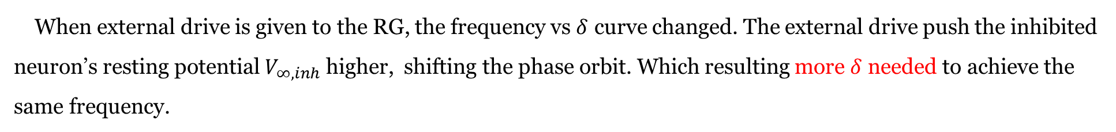
External drive shifts the phase orbit to change performance of the CPG.
When external drive is given to the RG, the frequency vs $δ$ curve changed. The external drive push the inhibited neuron’s resting potential $V_{∞,inh}$ higher, shifting the phase orbit. Which resulting more $δ$ needed to achieve the same frequency.

Slide 27
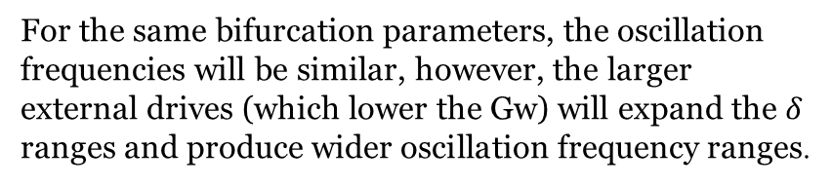
Raise the Gw value, given a external drive.
For larger given drives, a lower Gw is needed to achieve the same bifurcation parameter.
For the same bifurcation parameters, the oscillation frequencies will be similar, however, the larger external drives (which lower the Gw) will expand the $δ$ ranges and produce wider oscillation frequency ranges.

Slide 28
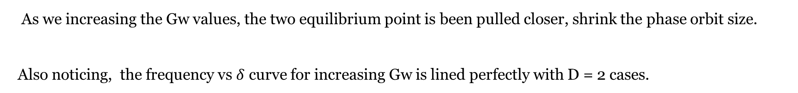
Raise the Gw value, produce the frequency vs $δ$ curve. (No drive)
As we increasing the Gw values, the two equilibrium point is been pulled closer, shrink the phase orbit size.
Also noticing, the frequency vs $δ$ curve for increasing Gw is lined perfectly with D = 2 cases.

Slide 29


Keep Gw as zero, produce the phase response curve using rat’s neural parameters. (external drive involved)
$$δ=0.01$$
$$δ=0.3$$
Description

Slide 30


Raise the Gw value, produce the phase response curve. (No drive)
$$δ=0.01$$
$$δ=0.3$$
Description

Slide 31


Raise the Gw value, given a external drive.
$$δ=0.01$$
$$δ=0.3$$
Description

